Slide 1


Session_3
By Eng-Adham Khaled

Slide 2

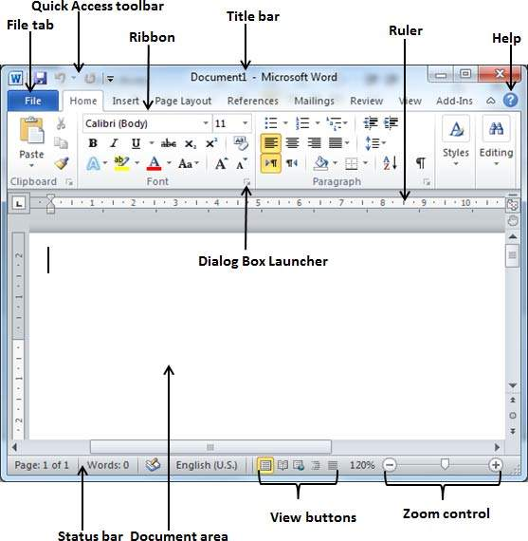
word-Screen layout

Slide 3
word-Screen layout

Slide 4
word-Screen layout

Slide 5
word-Screen layout

Slide 6
word-Screen layout

Slide 7
word-Screen layout

Slide 8
word-Screen layout

Slide 9
word-Screen layout

